Slide 1
Social media networks Checkpoint presented by BACEM SOUIBGUI
Introduction
Factual Arguments
Emotional Arguments
Rational Arguments
Recap

Slide 2
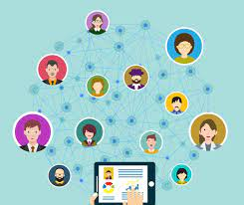
Introduction
Social networking can connect strangers across the world. As the evolution of communication continues, technology progresses and social networking grows. Social networks like Instagram, Twitter, and Facebook have grown to have billions of users.
but I think Social media networks degrade human relationships for many reasons:

Slide 3
Factual Arguments
Argument 1
People are easy to be influenced and be emotional by those mobile media.
When people overestimate the level of intimacy via mobile media, they will become very susceptible to their relationships in mobile media. Here I still want to use Weibo or Twitter as examples. Twitter has a large number of users from people all around the world, and these users can post anything they want online, no matter what it is: positive or negative, good or bad, right or wrong. Sometimes, strong and powerful words can be so infectious to readers. We will be affected by emotional contagion.

Slide 4
Argument 2
In today's society, many people are addicted to using various forms of technological devices. Having such convenient access to technology allows people to spend an unnecessary amount of time on social media.
Argument 3
Self-Esteem
Social media has a very strong impact on self-esteem. People tend to portray their lives to be "flawless" or "picture perfect" when, in reality, it's completely different when behind the scenes. When we only get the highlights of other people's lives, we end up comparing them to ourselves.

Slide 5
EMOTIONAL ARGUMENTS
Argument 1
Disconnection with elderly people
Image a situation like this: It is a Christmas dinner or other festive family dinner. All family members get together and are ready for a big dinner. However, the youngers hold mobile phones in their hands and keep chatting with someone in their mobile media. The family dinner is supposed to be an opportunity for face-to-face and heart-to-heart talk, especially a precious time to talk with the aged in the whole family. It is hard for elderly people to know how to use social mobile media.

Slide 6
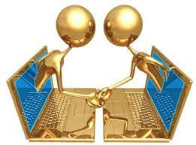
Argument 2
Before technology was designed, people communicated face-to-face with one another. In recent years, social media has become the most profound source of communication. We all know that with power comes great responsibility, but in some instances, there aren't always positives to power. Originally, social media was created as a networking tool, but it has been used for much more.

Slide 7
Argument 3
Social media tends to change your relationship styles in many ways. It allows you to connect with more people in very little time. It eases out the level of intimacy that you might share with people online. It also makes you more vulnerable to other people's behaviors, attitudes and beliefs.

Slide 8
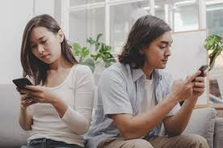
Rational arguments
Argument 1
More and more studies have been released that reveal social media’s harmful role in marriages. Researchers have found that increased social media usage could lead to more relationship problems, infidelity, and even divorce.

Slide 9
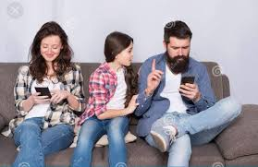
Argument 2
Excessive social media use is linked to couples fighting more. A 2013 study found that, among couples who had been together for less than three years, spending more time on Facebook was linked with more "Facebook-related conflict" and more negative relationship outcomes.

Slide 10
Argument 3
A study conducted in 2018 by Brigham Young University found that extensive social media usage is linked with decreased emotional wellness and lower satisfaction in interpersonal relationships

Slide 11
RECAP
While social media might not ruin relationships, it may create problems if you and your partner lean on these alternative modes of communication. “You need to be able to see the look in someone's eye—their micro-expressions—the tone of their voice, and you can't do that on social media,” says Shore.

Slide 12
Thank you

